Slide 1
Data visualization of “Distribution of apartments between districts”
Alatau Akhmet-Sultan Aksha Ayan Myrzash Abzal

Slide 2
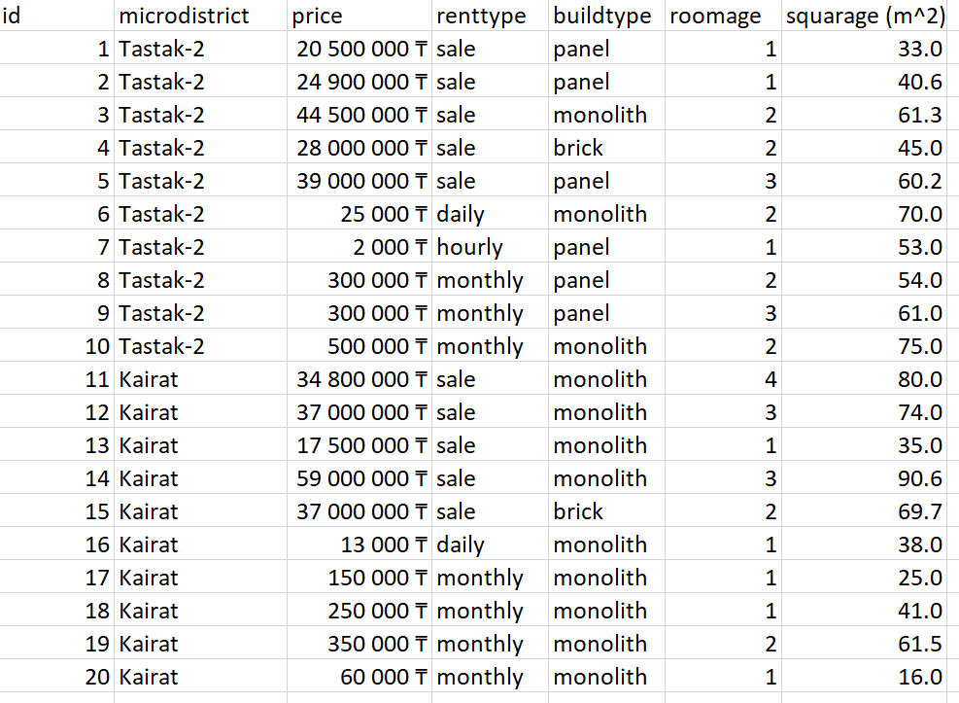
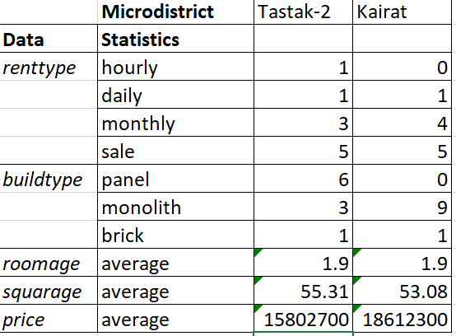
Data from Tastak-2 and Kairat
10 flats from Tastak-2 and 10 flats from Kairat

Slide 3
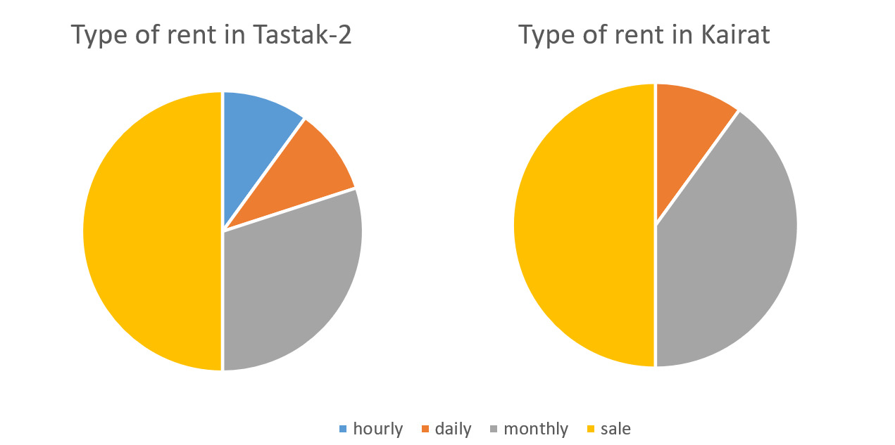
Type of buildings

Slide 4
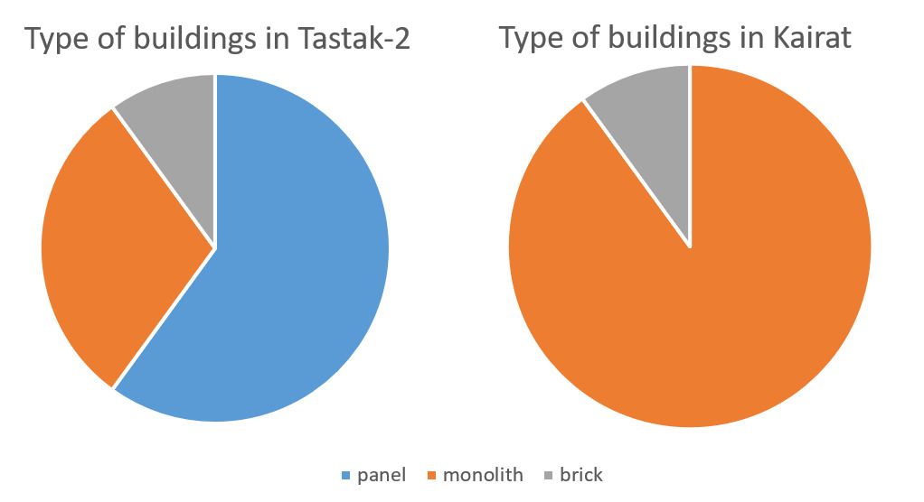
Type of buildings

Slide 5
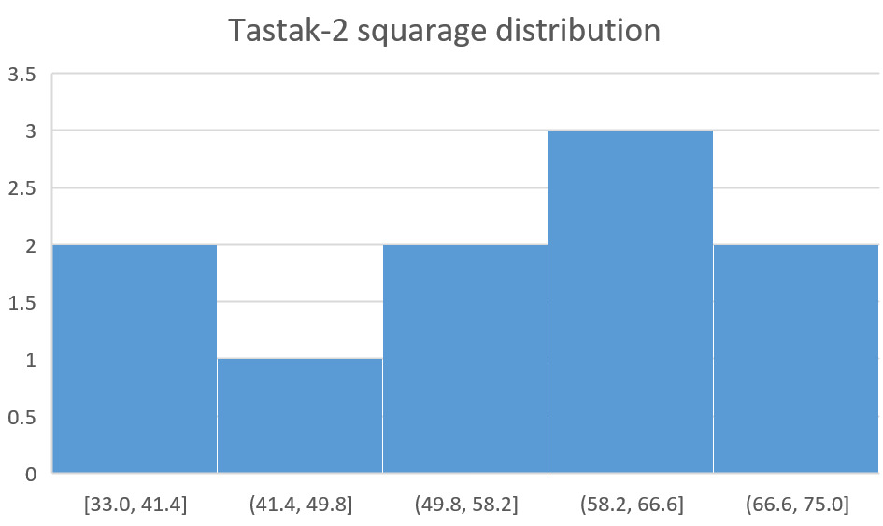
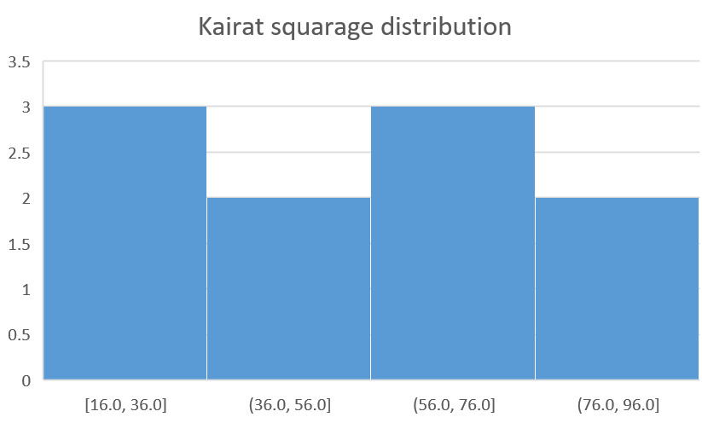
Squarage disribution

Slide 6
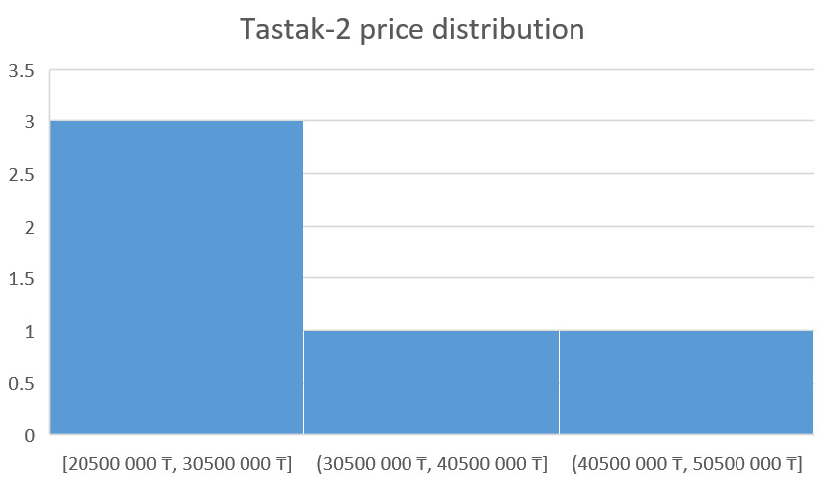
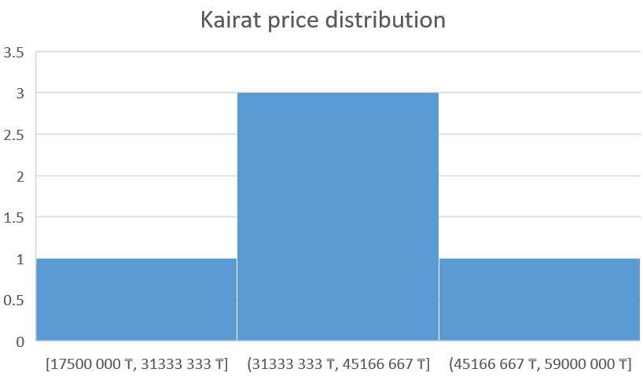
Price distribution

Slide 7
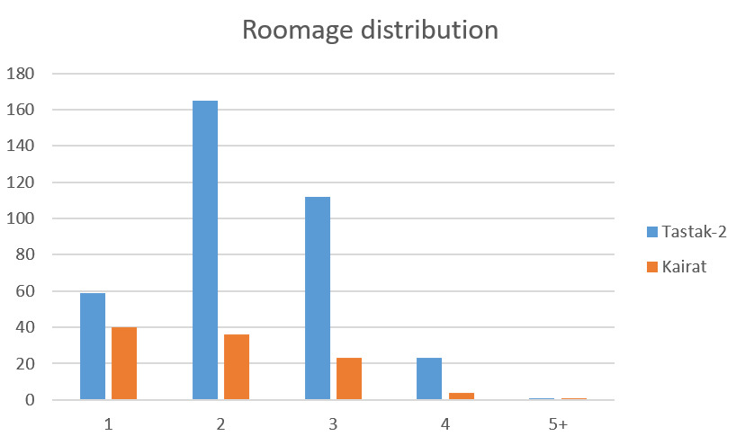
Roomage distribution

Slide 8
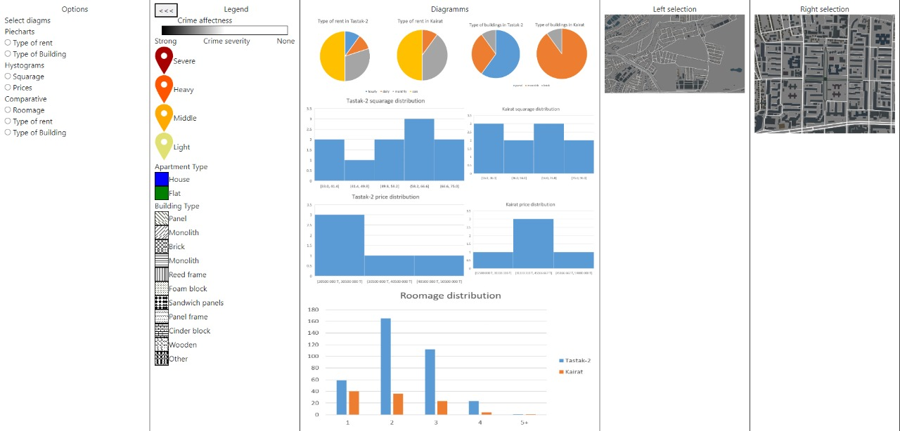
Full webpage

